Slide 1
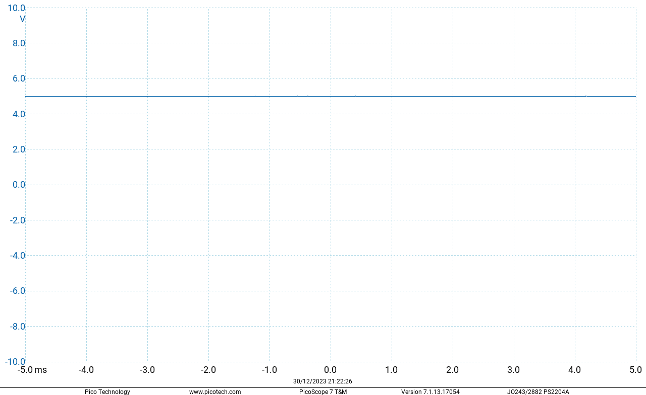

Exercise E2
$$V_{USB}=5.012V$$

Slide 2
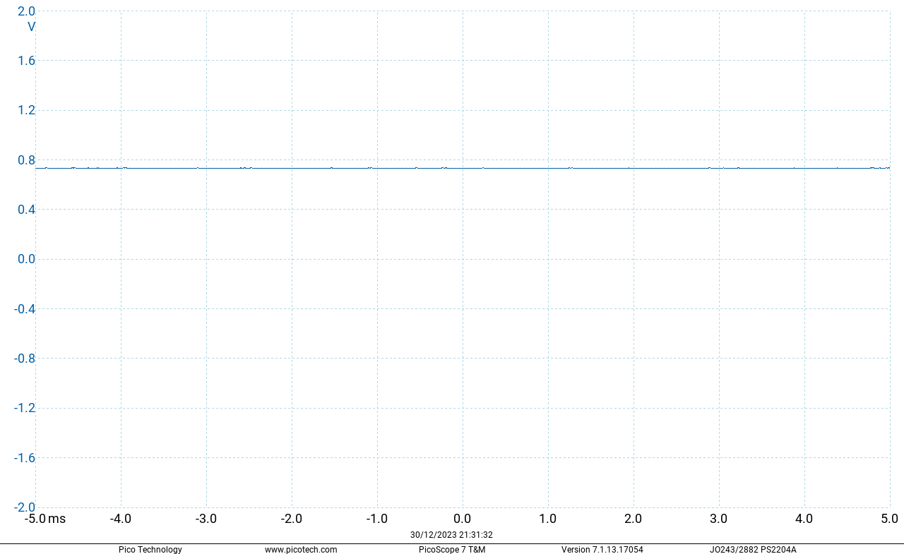

Exercise E2
$$V_{f}=0.729V$$

Slide 3
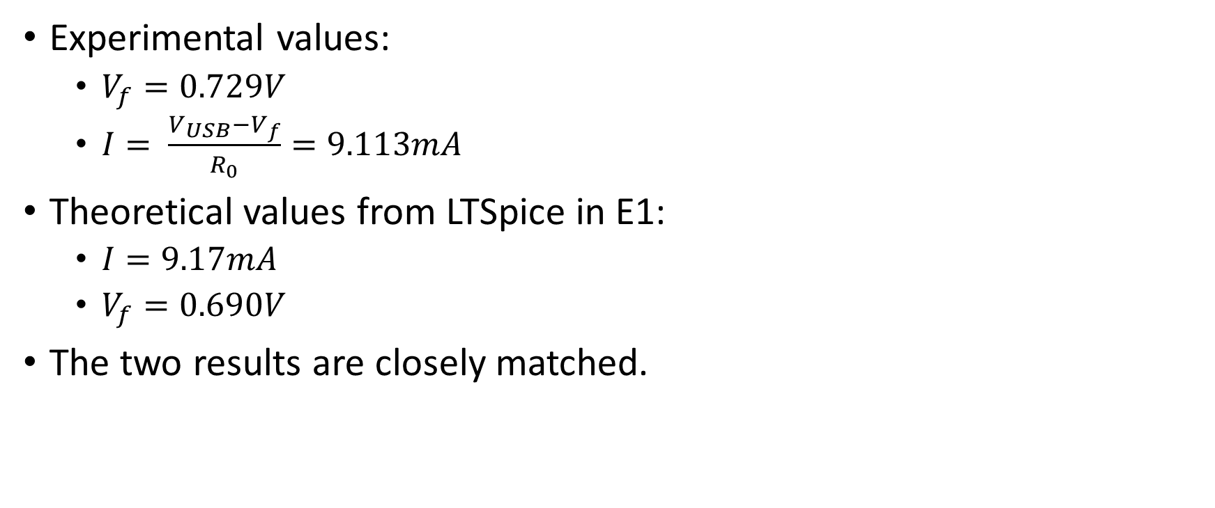
Exercise E2
Experimental values:
$V_{f}=0.729V$
$I= \frac{V_{USB}−V_{f}}{R_{0}}=9.113mA$
Theoretical values from LTSpice in E1:
$I=9.17mA$
$V_{f}=0.690V$
The two results are closely matched.

Slide 4
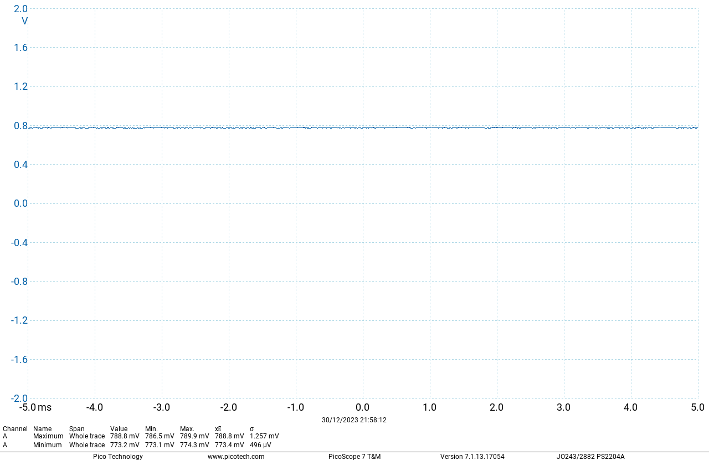

Exercise E2
1N4001:
$V_{f}=0.700V$

Slide 5
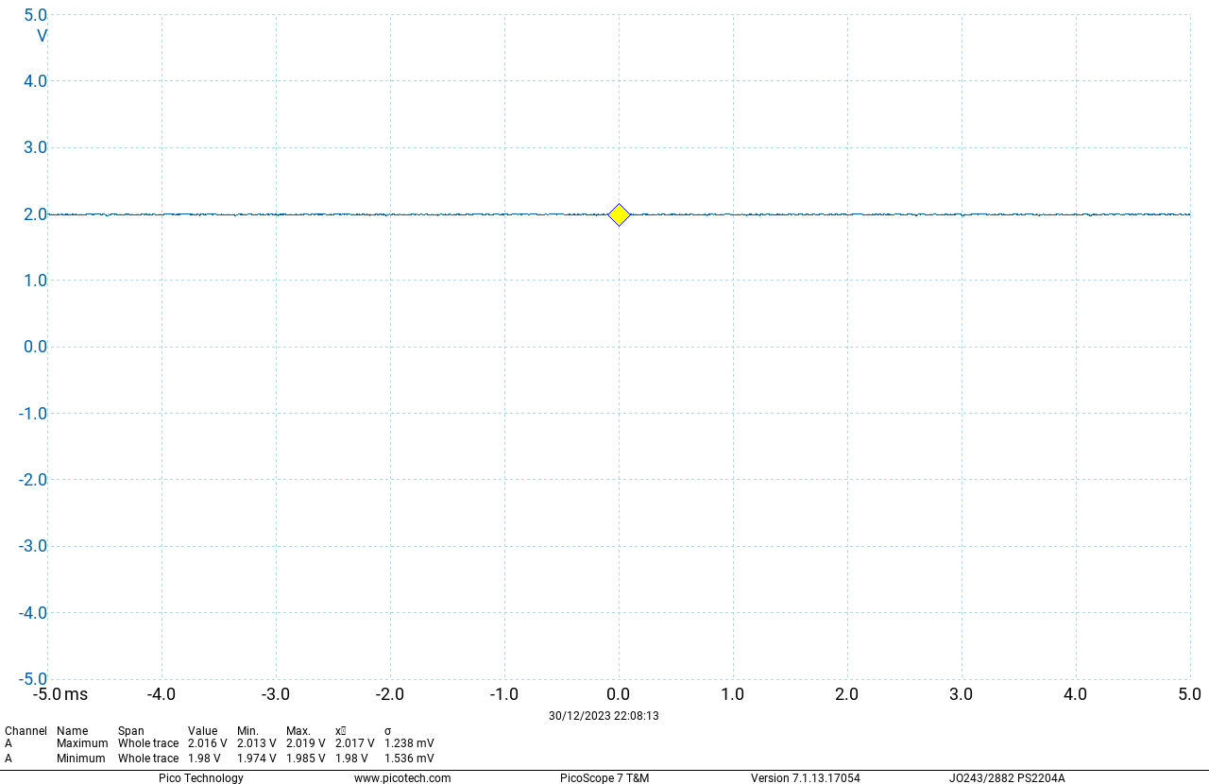

Exercise E2
Yellow LED:
$V_{f}=2.000V$

Slide 6
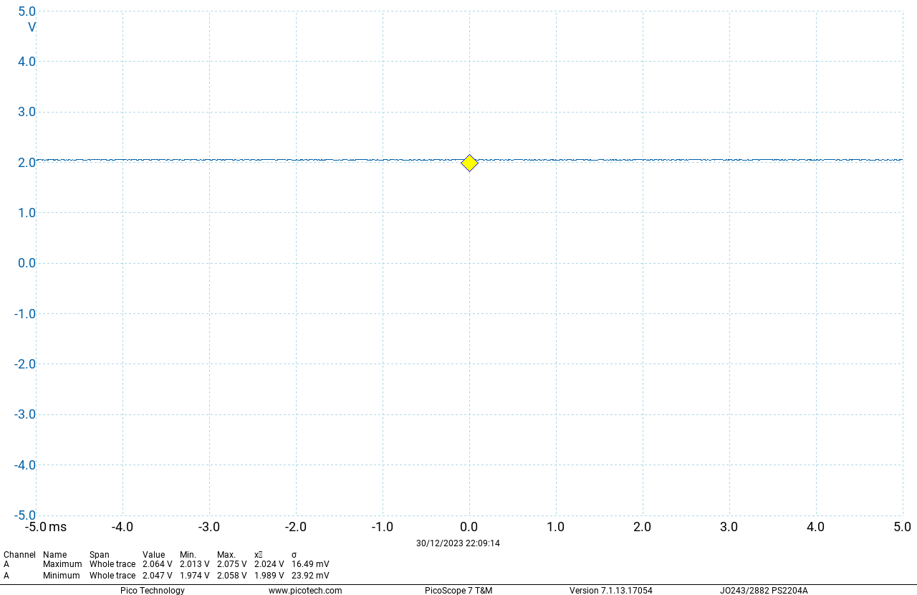

Exercise E2
Green LED:
$V_{f}=2.057V$

Slide 7

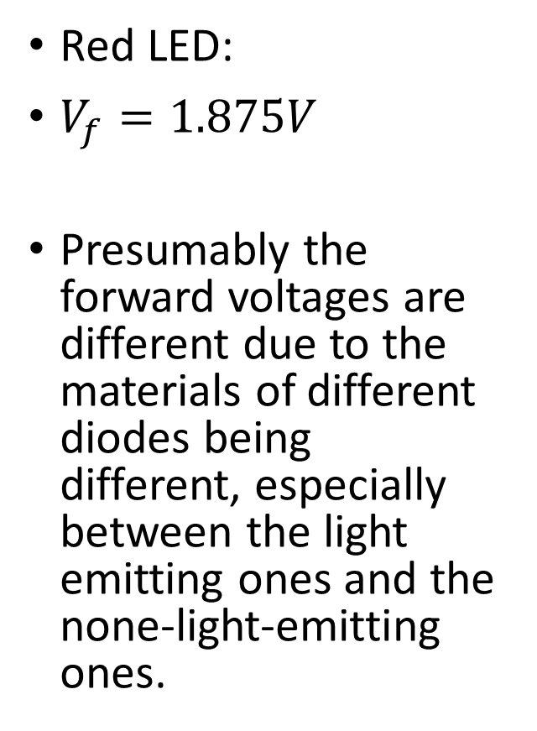
Exercise E2
Red LED:
$V_{f}=1.875V$
Presumably the forward voltages are different due to the materials of different diodes being different, especially between the light emitting ones and the none-light-emitting ones.

Slide 8
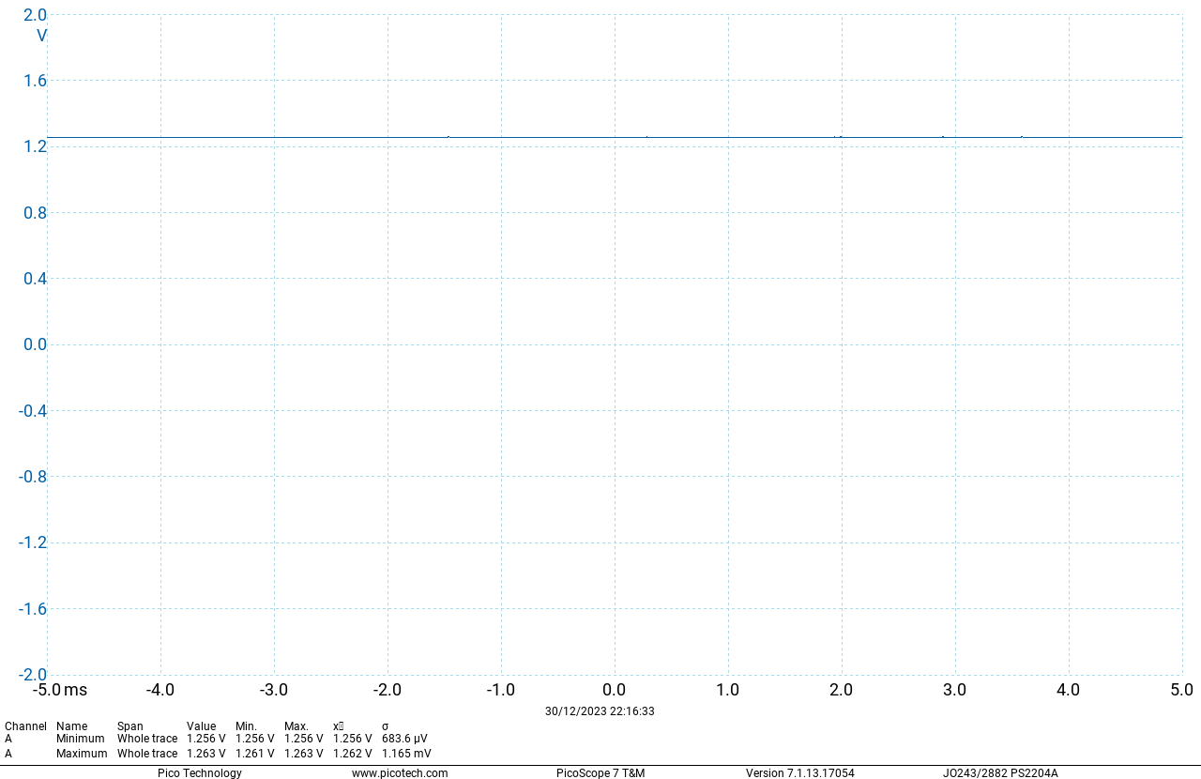

Exercise E2
Infrared Red LED:
$V_{f}=1.260V$

Slide 9
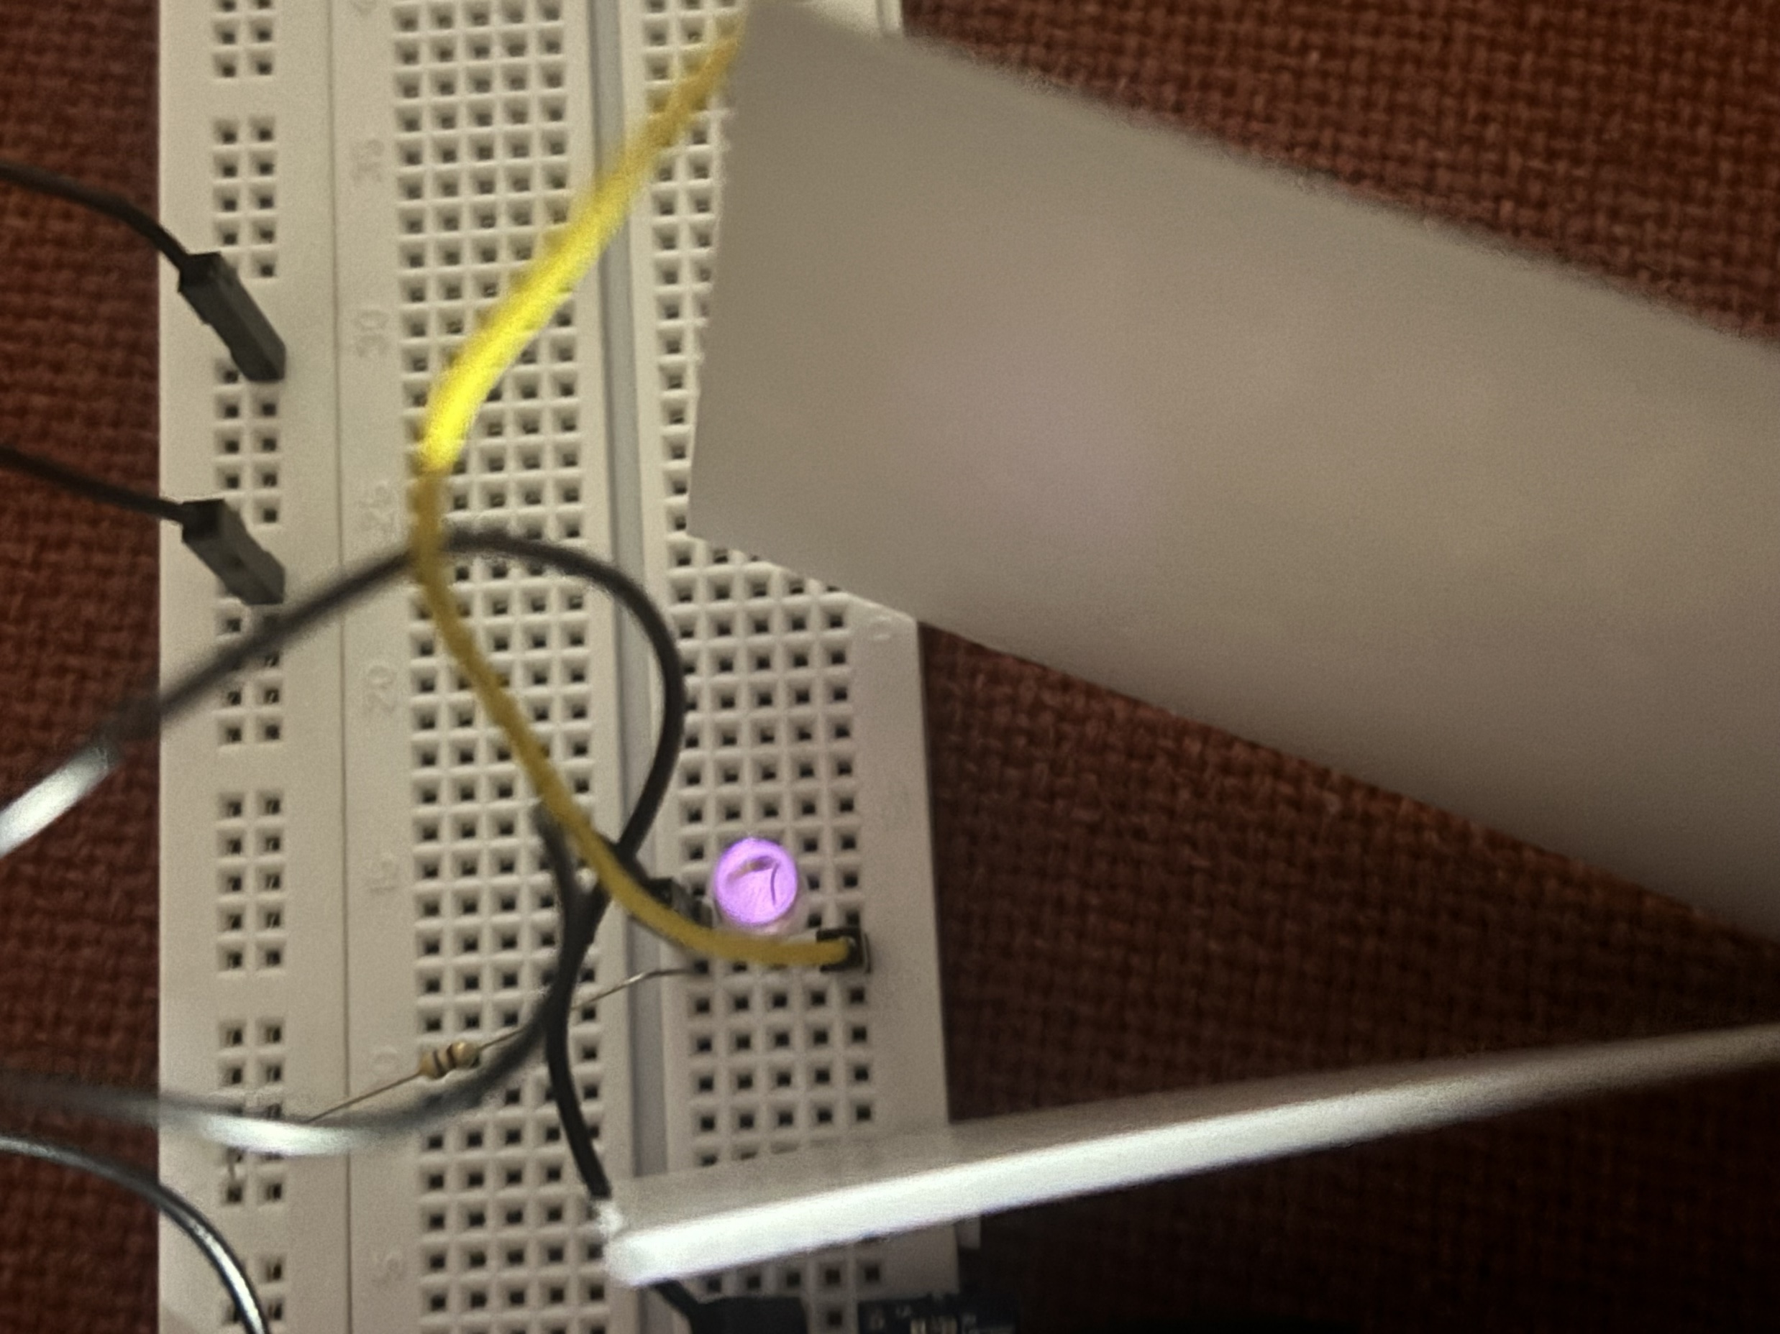
Exercise E2
Infrared light can be seen with phone cameras
The photo in the left is taken with most light sources turned off and the only light source blocked by a Christmas card – It seems like removing all light sources will make the photo blurry

Slide 10
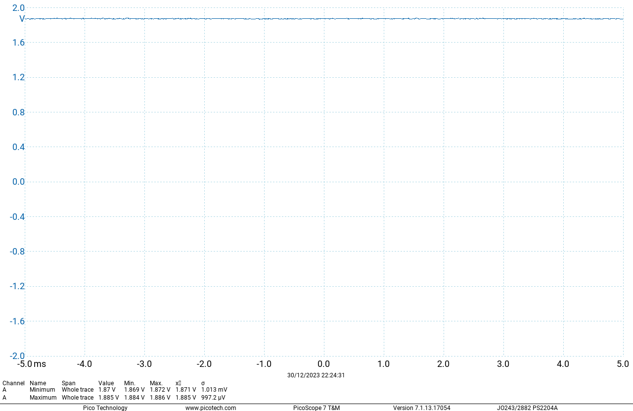
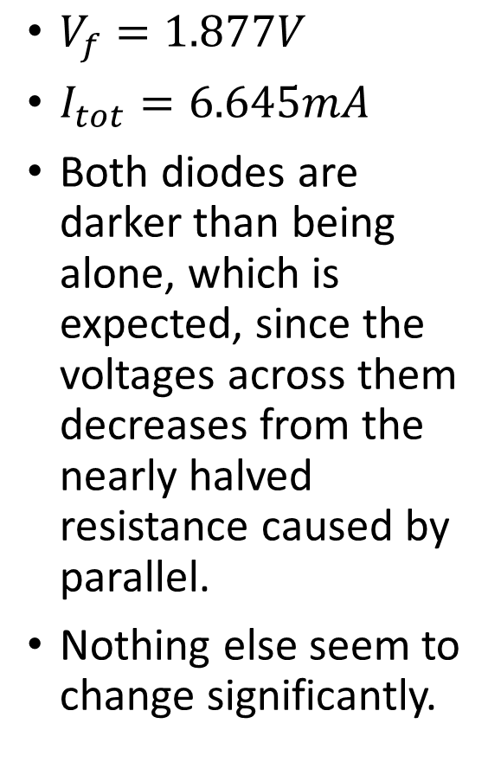
Exercise E2
$V_{f}=1.877V$
$I_{tot}=6.645mA$
Both diodes are darker than being alone, which is expected, since the voltages across them decreases from the nearly halved resistance caused by parallel.
Nothing else seem to change significantly.

